Slide 1
Unit 4: How do our neurons work together to control behaviors?

Slide 2
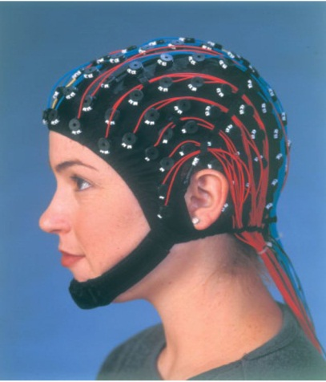
Neurological Disorders Lesson 4.1
What is sleep?

Slide 3
Do Now: What do you know about sleep?
With a partner, determine if the following statements are true or false.
You will die if you don’t get enough sleep.
You sleep so your body can repair itself from the day’s activities.
You can’t perform properly if you don’t get enough sleep.
When you’re asleep, your brain is less active than when you’re awake.

Slide 4
1. You will die if you don’t get enough sleep.
True. Rats who are deprived of sleep die within a couple of weeks.
If I am deprived of:
Air
Water
Food
Sleep
The outcome is: Death
Death
Death
Death

Slide 5
2. You sleep so your body can repair itself from the day’s activities.
False. There is no evidence that more repair occurs during sleep than during relaxed wakefulness.
X
=

Slide 6
3. You can’t perform properly if you don’t get enough sleep.
True. Being sleep deprived impairs performance to the same extent as being drunk.

Slide 7
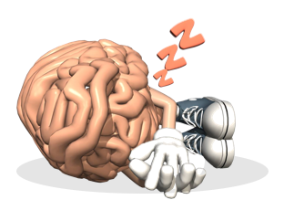
4. When you’re asleep, your brain is less active than when you’re awake.
False. Your brain is incredibly active during sleep.
X
<

Slide 8
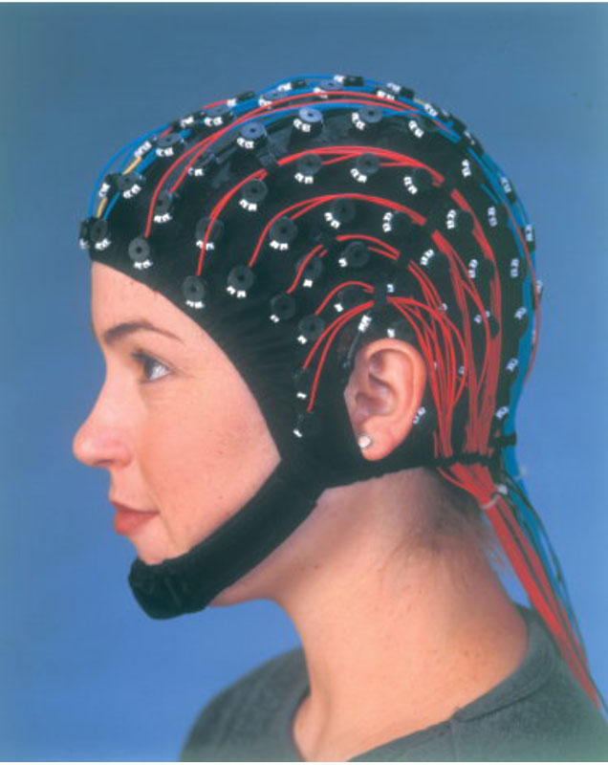
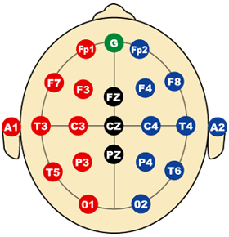
You can measure the brain’s activity during sleep with an EEG.
EEG – Electroencephalogram
The EEG cap
Placing the electrodes

Slide 9
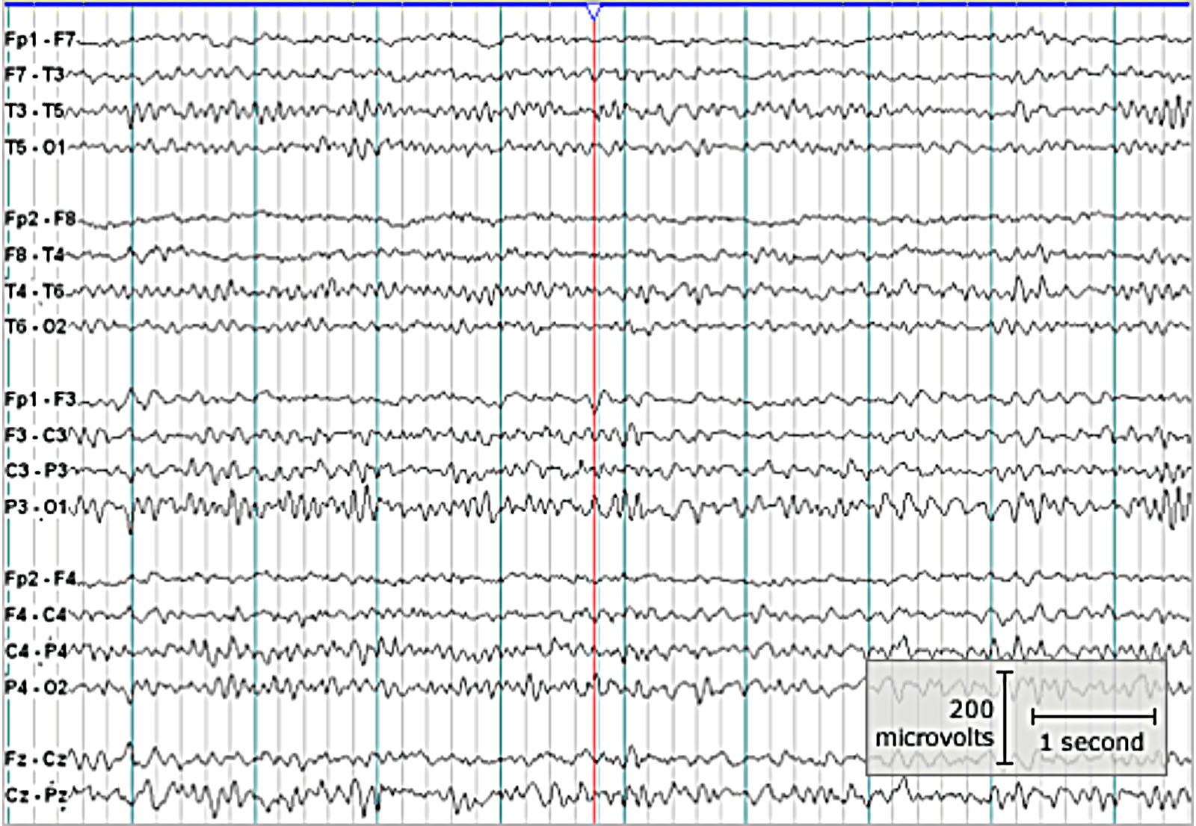
The EEG measures activity between electrodes
An awake subject

Slide 10
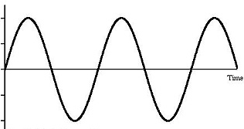
The EEG records activity in the form of waves
When talking about a wave:
What is frequency?
What is amplitude?
A
Amplitude
B
Frequency

Slide 11
What do the brainwaves signify?
Mentally alert with eyes open
High frequency, low amplitude
Awake with eyes closed
Medium frequency, medium amplitude
Drowsiness & sleep
Low frequency, high amplitude
Epilepsy
High frequency, high amplitude

Slide 12
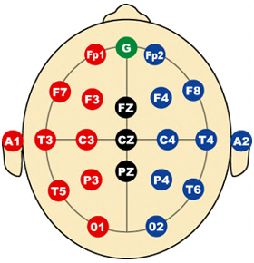
Activity: Reading an EEG
C. Low amplitude
D. High amplitude
C.
A. High frequency
E.
D.
A.
B. Low frequency
B.
E. High frequency & amplitude

Slide 13
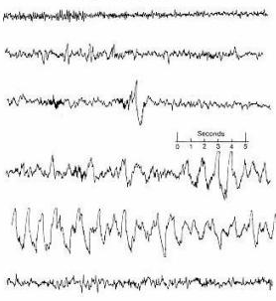
The EEG detects multiple stages of sleep
Awake
Stage 1
Non rapid eye movement
(NREM)
Stage 2
Stage 3
Stage 4
Rapid eye movement (REM)
Stage 5

Slide 14
Two Types of Sleep
Non rapid eye movement (NREM)
The sleeper is relatively still
Decrease in heart rate, respiration and blood pressure
The eyes are pointed down and move slowly
Rapid eye movement (REM)
Muscle paralysis occurs (other than muscles that control breathing and eye movements)
Variable heart rate, respiration, and blood pressure
The eyes move back and forth rapidly
Most dreaming occurs

Slide 15
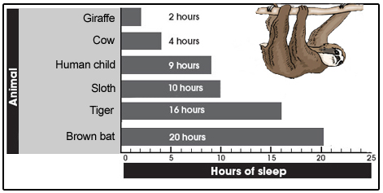
Wrap Up: How much is enough sleep?

